Slide 1

Croeso / Welcome
Mr A Thompson
Headteacher

Slide 2
Key Staff
Miss James Assistant Head
    Head of Key Stage 3
Miss C Lester Progress Leader
Mrs L Worgan ALNCo

Slide 3
Wider Support Staff
Wellbeing Team
Mrs Street
Mrs Morgan
Mr Hazel
Miss Plumley

Slide 4
Year 6 Links
Transition Day – June 26th
Information gathering visits
The school show- Monday 7th July
Google Classroom

Slide 5
New experiences
Major change / event
More pupils
New routine
More homework
Earlier start
More organised
Different teachers
New subjects
New friendships

Slide 6
The First Day
Tuesday 2nd September
8.20 am Pupils to arrive at school
Start 8.30 am – Pupils go to the hall
Finish 2.45 pm
Pupils will be placed into forms and will meet their new form tutors

Slide 7
School Journey
Walk / Car / Bus / Train
Calzaghe Bridge
Cars – pick up and drop off - train station or McDonald’s car park or leisure centre
Crossing and bus stops are supervised at end of day

Slide 8
Lunch
About £2.50 - £ 4.00 per day
Meal of the day £ 2.50
Break and lunch
Pupils pay through finger recognition machine (cashless system) – parental permission required
Pupils bring in money for the first week
Parents can add money via ParentPay

Slide 9
Mobile Phones
NOT permitted to use mobile phones
Carried for safety
Switched off in school
Kept in bags
Pupils’ responsibility
Confiscated if used inappropriately
Persistent use – parents to collect

Slide 10
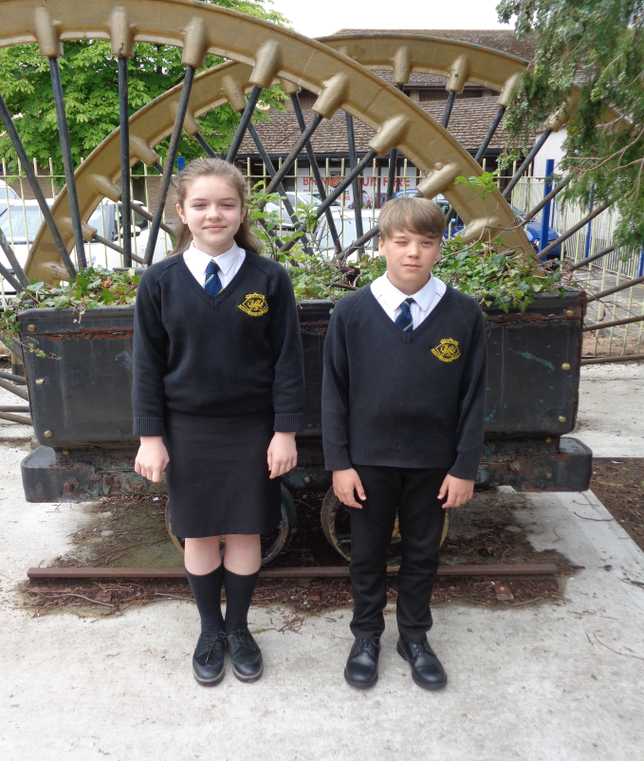

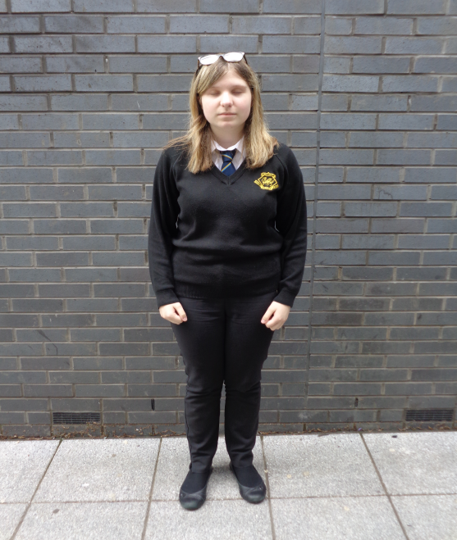
Uniform and Suppliers
Morgan Sports, Crosskeys
Regis, Newbridge
Preloved uniform shop
See our uniform list
Includes P.E. kit

Slide 11
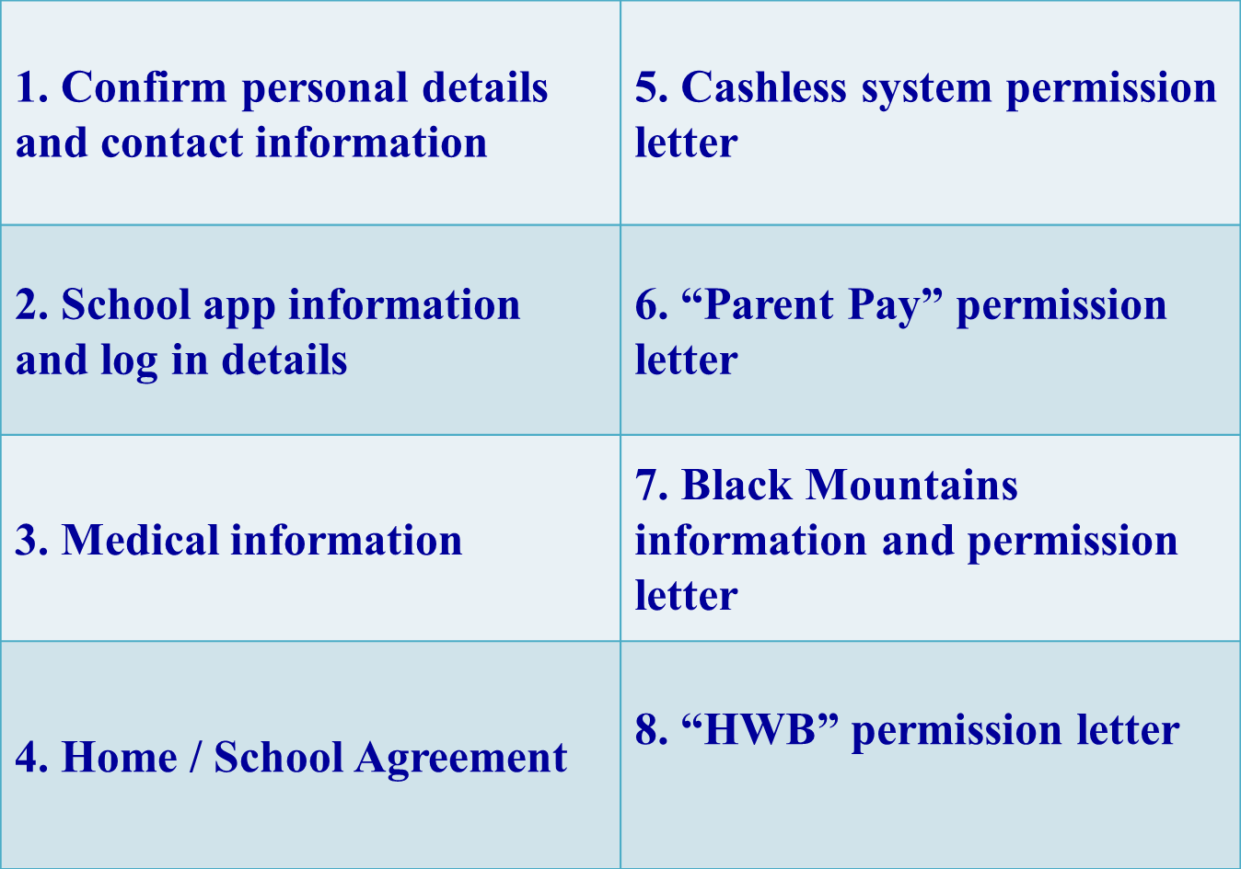
Start of Term Parents’ Pack

Slide 12
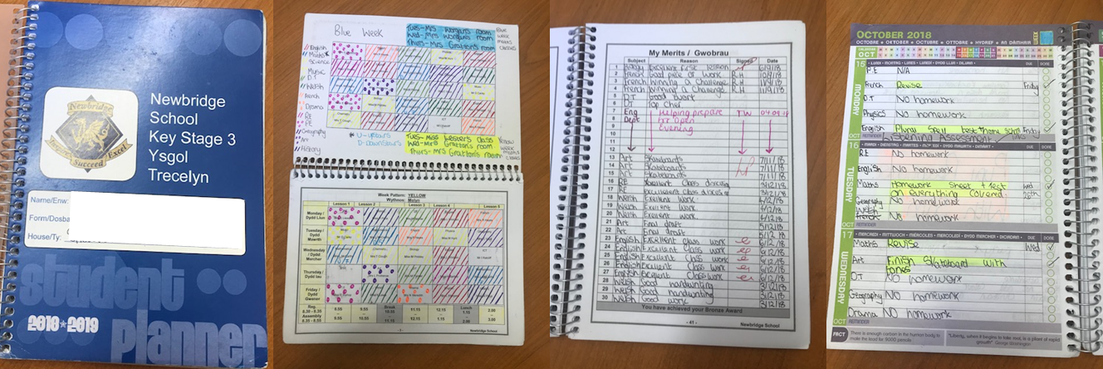
Pupil Planners
Timetable for each pupil / form
Space to record homework on a daily basis
Notes pages
Parents’ weekly signing page / message page

Slide 13
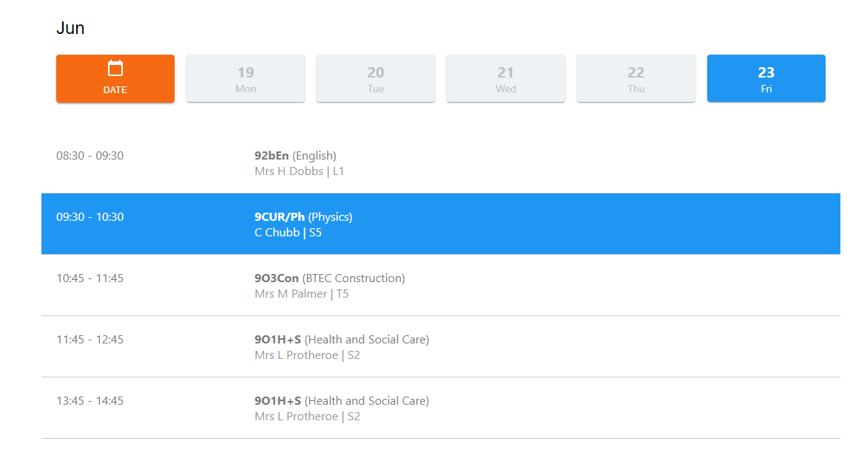
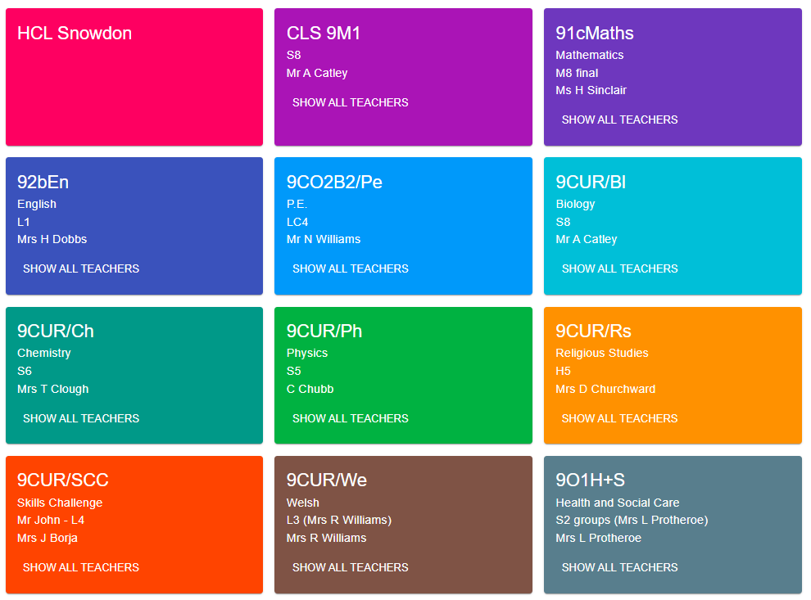
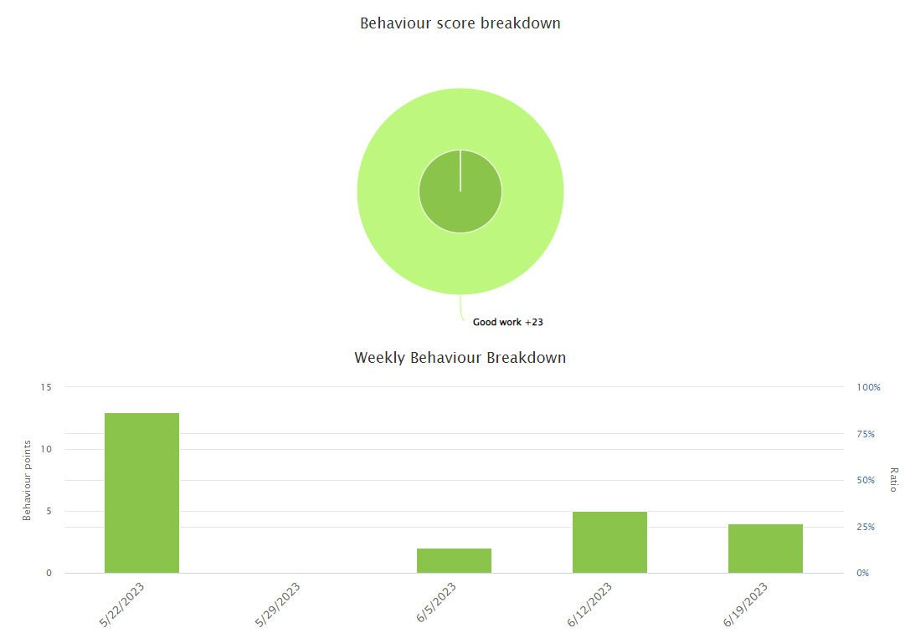
Class Charts
Records positive behaviour and rewards
(good work/ kindness/ Pupil of the Week)
Tracks homework set
Monitor behaviour, attendance and punctuality
Timetables can be viewed
Parents and pupils can download the app and monitor these things on phones/tablets

Slide 14
Timetable

Slide 15
B Behaviour Breakdown

Slide 16
Communication
Contact the Form Tutor - phone, email or planner
Contact the Progress Leader - school office / email
Raise concerns with the school directly – avoid social media
Two way information via our school apps (MyEd)
Parents Evening- Spring Term
School email: newca@caerphilly.gov.uk

Slide 17
Subjects
Second year of the new curriculum
Pupils will be taught in distinct subject areas
5 lessons per day
Deepening of links between subjects across the school
Areas of Learning:
Language Literacy & Communication
Mathematics and Numeracy
Science and Technology
Humanities
Expressive Arts
Health & Wellbeing

Slide 18
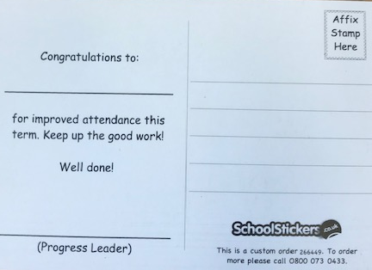


Merits and Rewards
Gain merits for good work, homework, effort, citizenship e.g. kindness to others
Positive Points on Classcharts
Certificates for number of merits
gained
Bronze, Silver, Gold, Pearl, Platinum etc
Attendance rewards
Postcards

Slide 19
Interim Repots
Subject | Subject Attainments | Skills Attainment | Effort in Class | Homework
English | In Line with Expectation | In Line with Expectation (Literacy) | Good | Good
Mathematics | In Line with Expectation | In Line with Expectation (Numeracy) | Good | Good
Science | Exceeding Expectation | Exceeding Expectation (Digital Competency) | Excellent | Excellent

Slide 20
Interventions
Academic information received from primary schools
Additional assessments in Autumn Term
            Reading
            Spelling
            Numeracy
Results of these will determine selection for Literacy and / or Numeracy intervention
You will be notified via letter

Slide 21
Types of Intervention
Registration Numeracy
Catch up Literacy
Literacy groups
Spelling
Numeracy groups
Registration Readers
Progress measured in the Spring Term

Slide 22
Wellbeing Intervention
Support from Pastoral Team
Wellbeing Mentors
CAHMS group sessions
Wellbeing groups and 1:1 sessions
School Counsellor
Family Engagement Officer
Education Welfare Officer

Slide 23
School Life and activities
The more you take part, the more you enjoy,
learn and progress
School clubs, trips and educational visits
Black Mountains / Pantomime visit / extra-curricular activities
School Council / Eco Council / Form Representatives / Junior Leaders / Bullying Ambassadors

Slide 24


